Slide 1
Year 10 Subject Selection for Stage 6
Year 11 - 2021 ~ Year 12 2022
For Year 10 students and their parents
at Liverpool Girls High School

Slide 2
Year 10 Subject Selection for Stage 6
Purpose of this presentation
This presentation has been developed to assist schools to provide relevant NSW Education Standards Authority (NESA) information to
Year 10 students and their parents for Year 11 2021 ~ Year 12 2022.

Slide 3
Year 10 Subject Selection for Stage 6
Course Selection Considerations
Abilities
Interests/Motivation
Career aspirations and needs
Syllabus requirements - Practical/Major work components
Subject combinations
Other commitments
Notes:
Abilities - choose subjects where you are capable of doing well.
Interests/Motivation- choose subjects that interest you.
Career aspirations and needs - keep in mind future career paths but be realistic about choices.
Syllabus Requirements – be mindful of how many practical works and major works are required for your pattern of study and the timing of submission.
Subject combinations - do the subjects complement each other?
Other commitments - when choosing subjects, it its important to balance study with outside commitments and influences such as work, sport and family.
https://educationstandards.nsw.edu.au/wps/portal/nesa/11-12/hsc/subject-selection

Slide 4
Year 10 Subject Selection for Stage 6
The Higher School Certificate
is the culmination of a student’s school career
is the highest educational award that can be achieved at secondary school in NSW
reports student achievement in terms of a standard achieved in individual courses
presents a profile of student achievement across a broad range of subjects
Notes:
http://educationstandards.nsw.edu.au/wps/portal/nesa/11-12/hsc/subject-selection

Slide 5
Year 10 Subject Selection for Stage 6
HSC Course Structure
All courses in the HSC have a unit value
Most courses are 2 units which equates to 120 hours of study and a HSC result out of 100
Some courses are 1 unit. This is equivalent to 60 hours of study and a HSC result out of 50
Many 1 unit courses are extension courses, enabling 3 or 4 units of a course to be studied
Notes:
http://educationstandards.nsw.edu.au/wps/portal/nesa/11-12/hsc/subject-selection
https://ace.nesa.nsw.edu.au/ace-8064

Slide 6
Year 10 Subject Selection for Stage 6
Requirements for the HSC
Year 11
minimum of 12 units
students must satisfactorily complete the Year 11 course before commencing the corresponding Year 12 course
Year 12
minimum of 10 units
Notes:
Students may accumulate course units towards the HSC for a period of up to 5 years.
Students may choose to undertake this ‘pathway’ approach for a variety of reasons including:
commitments outside school - part time work, elite sportsperson etc.
apprenticeship or traineeship
acceleration
repeating
http://educationstandards.nsw.edu.au/wps/portal/nesa/11-12/hsc/subject-selection
https://ace.nesa.nsw.edu.au/ace-8036

Slide 7
Year 10 Subject Selection for Stage 6
Requirements for the HSC
Both the Year 11 and Year 12 pattern of study must include:
2 units of compulsory English
at least 6 units of Board Developed Courses
at least 3 courses of 2 units value or greater
at least 4 subjects (including English)
a maximum of 6 units of Science may be included in the Year 11 pattern of study.
a maximum of 7 units of Science may be included in the Year 12 pattern of study.
Notes:
English is mandatory for the HSC.
English Studies and Mathematics Standard 1 are Board Developed Courses with an optional HSC examination. Students who choose English Studies and/or Mathematics Standard 1, but wish to receive an ATAR, must undertake the optional examination.
Extension course are not separate subjects. E.g. Advanced English (2 units) + Extension 1 (1 unit) + Extension 2 (1 unit) = 4 units but only 1 subject.
At most, 6 units of courses in Science can be included in the pattern of study for Year 11. However, from 2019 Year 12, this increases to 7 units of Science, to allow for the study of Science Extension.
https://ace.nesa.nsw.edu.au/ace-8005

Slide 8
Year 10 Subject Selection for Stage 6
Requirements for the HSC – meeting the minimum standard in literacy and numeracy
From 2020, students need to demonstrate they have met a minimum standard in literacy and numeracy to be eligible for a HSC.
Students will show they meet the HSC minimum standard by passing online tests of basic literacy and numeracy skills, which are available for them to sit when they are ready in Year 10, 11 and 12 and after the HSC.
Notes:
https://ace.nesa.nsw.edu.au/ace-4060
https://educationstandards.nsw.edu.au/wps/portal/nesa/11-12/hsc/hsc-minimum-standard

Slide 9
Year 10 Subject Selection for Stage 6
About the minimum standard online tests
Students get up to four times per year to sit each minimum standard reading, writing or numeracy test.
The test is available on all school days
About the tests:
Reading: 45 multiple choice computer adaptive questions (45 minutes)
Numeracy: 45 multiple choice computer adaptive questions (45 minutes)
Writing: answer one question out of a choice of two prompts.
Refer to the NESA website for more information and resources for parents, students and schools
Notes:
https://educationstandards.nsw.edu.au/wps/portal/nesa/11-12/hsc/hsc-minimum-standard/online-tests

Slide 10
Year 10 Subject Selection for Stage 6
Types of HSC Courses
Board Developed Courses | Board Endorsed Courses
HSC examination except for: optional examination in English Studies and Mathematics Standard 1 and VET Curriculum Framework courses all Life Skills courses | No HSC examination – school-based assessment only
May be included in the calculation of a student’s Australian Tertiary Admission Rank (ATAR). | Not included in the calculation of a student’s Australian Tertiary Admission Rank (ATAR).
Includes some Vocational Education and Training (VET) courses. | Includes some Vocational Education and Training (VET) courses.
Includes Life Skills courses.
Notes:
Board Developed Courses are developed by NESA and all students in the state study the same course content and complete the same HSC examination. These courses may contribute to the calculation of a student’s ATAR . Life Skills Courses do not have an examination and are not included in the calculation of an ATAR.
Board Endorsed Courses have syllabuses endorsed by NESA to cater for a wide candidature in areas of specific need not served by Board Developed Courses. These courses may offer an alternative career path for students.
https://ace.nesa.nsw.edu.au/ace-6001
https://ace.nesa.nsw.edu.au/ace-6005

Slide 11
Year 10 Subject Selection for Stage 6
Board Developed Courses and the ATAR
Category A Courses | Category B Courses
May be included in the calculation of a student’s Australian Tertiary Admission Rank (ATAR) | No more than 2 units of Category B courses can be included in the calculation of a student’s ATAR
Compulsory HSC Examination for most courses | Optional HSC examination for some courses
 | Include VET Curriculum Framework courses and have compulsory work placement.
Notes:
It is the responsibility of the Universities Admission Centre (UAC) to determine if a course can be included in the calculation of the ATAR.
Category A Courses have academic rigour and depth of knowledge to provide background for tertiary studies. Examples include Biology and Geography.
Category B Courses - no more than two units of Category B courses can be included in the ATAR calculation. Examples include Human Services and Hospitality.
Course category listings available at the UAC Website: https://www.uac.edu.au/future-applicants/atar/atar-courses. Go to HSC Board Developed courses to be examined in 2020 pdf.

Slide 12
Year 10 Subject Selection for Stage 6
SATISFACTORY COMPLETION OF A COURSE
Students must:
follow the course developed or endorsed by NESA
apply themselves with diligence and sustained effort to the set tasks and experiences provided in the course by the school, and
achieve some or all of the course outcomes
where applicable, complete mandatory work placement.
Notes:
https://ace.nesa.nsw.edu.au/ace-8019
https://educationstandards.nsw.edu.au/wps/portal/nesa/11-12/hsc/rules-and-processes

Slide 13
Year 10 Subject Selection for Stage 6
ADDITIONAL COMPLETION REQUIREMENTS FOR HSC COURSES
Students must:
complete HSC assessment tasks that contribute in excess of 50 per cent of available marks in courses where internal assessment marks are submitted, and
sit for and make a serious attempt at any requisite Higher School Certificate examinations for a course
Notes:
https://ace.nesa.nsw.edu.au/ace-8020
https://ace.nesa.nsw.edu.au/ace-8026

Slide 14
Year 10 Subject Selection for Stage 6
Confirmation of Entry
Students will receive a NESA Confirmation of Entry from the school
Before signing the Confirmation of Entry each year (Years 10, 11 and 12) students should check that they are:
enrolled in the correct courses
eligible for:
Year 10: Record of School Achievement
Year 11: Stage 6 Preliminary
Year 12: HSC
Notes:
https://ace.nesa.nsw.edu.au/ace-4003

Slide 15
Year 10 Subject Selection for Stage 6
HSC: All My Own Work
HSC: All My Own Work is a mandatory program designed to help HSC students to follow the principles and practices of good scholarship.
It consists of five modules:
Scholarship Principles and Practices
Acknowledging Sources
Plagiarism
Copyright
Working with Others
Notes:
Students must complete HSC: All My Own Work or its equivalent before they can be enrolled for any Preliminary or HSC course with NESA via Schools Online.
Only students entered for Stage 6 Life Skills courses are exempt from this requirement.
The HSC: All My Own Work program is integrated with other NSW syllabuses and programs. The program is designed to be delivered flexibly as self-paced learning modules.
The program is available on the NESA website: https://educationstandards.nsw.edu.au/wps/portal/nesa/11-12/hsc/hsc-all-my-own-work

Slide 16
Features of some courses within Key Learning Areas (KLA’s)

Slide 17
Year 10 Subject Selection for Stage 6
English – Year 11
English Advanced
English Extension 1 (must be studied with Advanced)
English Standard
English EAL/D (English as an additional language or dialect)
English Studies
Notes:
English Standard is designed for students to increase their expertise in English to enhance their personal, educational, social and vocational lives. The English Standard course provides students with the opportunity to analyse, study and enjoy a breadth and variety of English texts to become confident and effective communicators.
English Advanced is designed for students who have a particular interest and ability in the subject and who desire to engage with challenging learning experiences that will enrich their personal, intellectual, academic, social and vocational lives. They study challenging written, spoken, visual, multimodal and digital texts that represent and reflect a changing global world.
English EAL/D addresses the needs of a specific group of students and shares the overall aim and rationale of English. When presented at the HSC, the English EAL/D course will satisfy NESA requirements for the study of English. The English EAL/D course is designed for students to become proficient in English to enhance their personal, educational, social and vocational lives. The course provides students with the opportunity to analyse, study and enjoy a breadth and variety of English texts to become confident and effective communicators.
English Studies is distinctive in its focus on the development of students’ language, literacy and literary skills. It is designed to provide students with opportunities to become competent, confident and engaged communicators and to study and enjoy a breadth and variety of texts in English. English Studies focuses on supporting students to refine their skills and knowledge in English and consolidate their English literacy skills to enhance their personal, educational, social and vocational lives. English Studies is a Board Developed Course, with an optional HSC examination, for those students wanting to enter university.
English Extension 1 provides students who undertake Advanced English and are accomplished in their use of English with the opportunity to extend their use of language and self-expression in creative and critical ways.
Students should seek advice from the English Faculty regarding their suitability for a particular course.
http://educationstandards.nsw.edu.au/wps/portal/nesa/11-12/stage-6-learning-areas/stage-6-english

Slide 18
Year 10 Subject Selection for Stage 6
English – Year 12
English Advanced
English Extension 1 (must be studied with Advanced)
English Extension 2 (must be studied with Extension 1)
English Standard
English EAL/D
English Studies
Notes:
English Advanced is designed for students who have a particular interest and ability in the subject and who desire to engage with challenging learning experiences that will enrich their personal, intellectual, academic, social and vocational lives. They study challenging written, spoken, visual, multimodal and digital texts that represent and reflect a changing global world.
English Extension 1 provides students who undertake Advanced English and are accomplished in their use of English with the opportunity to extend their use of language and self-expression in creative and critical ways.
English Extension 2 consists of a Major Work undertaken over 60 indicative hours of study. This course provides students with the opportunity to apply and extend research skills developed in the English Extension Year 11 course to their own extensive investigation and develop autonomy and skills as a learner and composer. English Extension 2 develops independent and collaborative learning skills and higher-order critical thinking that are essential at tertiary levels of study and in the workplace. The course is designed for students who are independent learners with an interest in literature and a desire to pursue specialised study of English.
English Standard is designed for students to increase their expertise in English to enhance their personal, educational, social and vocational lives. The English Standard course provides students with the opportunity to analyse, study and enjoy a breadth and variety of English texts to become confident and effective communicators.
English EAL/D addresses the needs of a specific group of students and shares the overall aim and rationale of English. When presented at the HSC, the English EAL/D course will satisfy NESA requirements for the study of English. The English EAL/D course is designed for students to become proficient in English to enhance their personal, educational, social and vocational lives. The course provides students with the opportunity to analyse, study and enjoy a breadth and variety of English texts to become confident and effective communicators.
English Studies is distinctive in its focus on the development of students’ language, literacy and literary skills. It is designed to provide students with opportunities to become competent, confident and engaged communicators and to study and enjoy a breadth and variety of texts in English. English Studies focuses on supporting students to refine their skills and knowledge in English and consolidate their English literacy skills to enhance their personal, educational, social and vocational lives.
In English Studies, students will be able to sit for an optional HSC examination and will be reported on a common scale with the English Standard and English Advanced courses. Students choosing not to sit for the English Studies HSC examination will still be eligible for the HSC if they have satisfactorily completed courses that comprise the pattern of study required by NESA. To be eligible for an ATAR, students studying the English Studies course must complete the optional HSC examination and include a further 8 units of Category A courses in their pattern of study.
Students should seek advice from the English Faculty regarding their suitability for a particular course.
http://educationstandards.nsw.edu.au/wps/portal/nesa/11-12/stage-6-learning-areas/stage-6-english

Slide 19
Year 10 Subject Selection for Stage 6
Creative Arts – Year 11 and Year 12
Dance
Drama
Music 1
Music 2
Visual Arts
Music Extension - Year 12 only (Study of Music 2 in Year 11 and continue the study of Music 2 throughout Year 12).
Notes:
Study in the Creative Arts provides students with strong discipline based knowledge and the fundamental skills, creative expertise, learning mindset and critical capabilities for the future world of work. Creative Arts students experience and develop the complex skills required to create and test ideas, generate creative works with confidence, shape inquiry and to critically evaluate and reflect on what they do. Study in the Creative Arts prepares students to be significant producers and informed consumers of culture.
https://educationstandards.nsw.edu.au/wps/portal/nesa/11-12/stage-6-learning-areas/stage-6-creative-arts

Slide 20
Year 10 Subject Selection for Stage 6
Human Society and Its Environment (HSIE) - Year 11 and Year 12
Legal Studies
Modern History
Society and Culture
Studies of Religion 1 and 2
Work Studies (CEC)
Aboriginal Studies
Ancient History
Business Studies
Economics
Geography
History Extension - Year 12 only (Study of Ancient History or Modern History in Year 11 and continue the study of at least one of these throughout Year 12).
Notes:
Human Society and its Environment is the study of how humans interact with the world, how society operates and how it is changing. Through the study of HSIE, students develop the skills to prepare them to actively and responsibly participate as informed citizens in the contemporary world.
https://educationstandards.nsw.edu.au/wps/portal/nesa/11-12/stage-6-learning-areas/hsie
History Extension provides students with opportunities to examine the way history is constructed and the role of historians. Students investigate the nature of history and changing approaches to its construction through sampling the works of various writers, historians and others involved in the practice of history. Students apply their understanding to undertake an individual investigative project, focusing on an area of changing historical interpretation.
Year 11 Ancient History or Modern History is a prerequisite for entry into Year 12 History Extension.
Year 12 Ancient History or Modern History is a co-requisite for Year 12 History Extension.

Slide 21
Year 10 Subject Selection for Stage 6
Languages – Year 11 and Year 12
Eligibility criteria apply to language courses:
Beginners
Continuers
Language in Context (Chinese, Indonesian, Japanese, Korean)
Language and Literature (Chinese, Indonesian, Japanese, Korean)
Extension courses are available for some Continuers courses
Notes:
Eligibility criteria apply language courses. Eligibility criterion is available at: https://ace.nesa.nsw.edu.au/ace-8008
https://educationstandards.nsw.edu.au/wps/portal/nesa/11-12/stage-6-learning-areas/stage-6-languages/eligibility
Language in Context usually have at least one parent who speaks the language at home, or may themselves have been born overseas and emigrated to Australia at a young age.
In languages where Extension courses are offered, the Extension courses are available to HSC Continuers course candidates only.
https://ace.nesa.nsw.edu.au/ace-6002
https://ace.nesa.nsw.edu.au/ace-8008
https://educationstandards.nsw.edu.au/wps/portal/nesa/11-12/stage-6-learning-areas/stage-6-languages/eligibility

Slide 22
Year 10 Subject Selection for Stage 6
Mathematics – Year 11
Mathematics Advanced
Mathematics Extension 1 (must be studied with Mathematics Advanced)
Mathematics Standard
Notes:
The Mathematics Advanced course is a calculus based course focused on developing student awareness of mathematics as a unique and powerful way of viewing the world to investigate order, relation, pattern, uncertainty and generality.
Mathematics Extension 1 is focused on enabling students to develop a thorough understanding of and competence in further aspects of mathematics. Mathematics Extension 1 provides a basis for progression to further study in mathematics or related disciplines in which mathematics has a vital role at a tertiary level. An understanding and exploration of Mathematics Extension 1 is also advantageous for further studies in such areas as science, engineering, finance and economics.
The Mathematics Advanced course must be chosen if students wish to study Mathematics Extension courses.
The Mathematics Standard courses are focused on enabling students to use mathematics effectively, efficiently and critically to make informed decisions in their daily lives. They provide students with the opportunities to develop an understanding of, and competence in, further aspects of mathematics through a large variety of real-world applications for a range of concurrent HSC subjects.
The Mathematics Standard course is a common course in the Preliminary year. Students, in consultation with the Mathematics faculty, nominate to do either Mathematics Standard 1 or Mathematics Standard 2, in the HSC year.
The study of mathematics is not compulsory for the HSC or ATAR.
http://educationstandards.nsw.edu.au/wps/portal/nesa/11-12/stage-6-learning-areas/stage-6-mathematics

Slide 23
Year 10 Subject Selection for Stage 6
Mathematics – Year 12
Mathematics Advanced
Mathematics Extension 1 (must be studied with Advanced)
Mathematics Extension 2 (must be studied with Extension 1)
Mathematics Standard 2
Mathematics Standard 1
Notes:
Mathematics Standard 1 is designed to help students improve their numeracy by building their confidence and success in making mathematics meaningful. This course offers students the opportunity to prepare for post-school options of employment or further training. This course offers an optional HSC examination.
Mathematics Standard 2 is designed for those students who want to extend their mathematical skills beyond Stage 5 but are not seeking the in-depth knowledge of higher mathematics that the study of calculus would provide. This course offers students the opportunity to prepare for a wide range of educational and employment aspirations, including continuing their studies at a tertiary level.
Students studying Mathematics Standard 1 may elect to undertake an optional HSC examination. The examination mark may be used by the Universities Admissions Centre (UAC) to contribute to the student’s Australian Tertiary Admission Rank (ATAR).
All students studying Mathematics Standard 2 will sit for an HSC examination.
Mathematics Advanced provides students with the opportunity to develop ways of thinking in which problems are explored through observation, reflection and reasoning. The course provides a basis for further studies in disciplines in which mathematics and the skills that constitute thinking mathematically have an important role. It is designed for those students whose future pathways may involve mathematics and its applications in a range of disciplines at the tertiary level.
Mathematics Extension 1 is focused on enabling students to develop a thorough understanding of and competence in further aspects of mathematics. Mathematics Extension 1 provides a basis for progression to further study in mathematics or related disciplines in which mathematics has a vital role at a tertiary level. An understanding and exploration of Mathematics Extension 1 is also advantageous for further studies in such areas as science, engineering, finance and economics.
Mathematics Extension 2 provides students with the opportunity to develop strong mathematical manipulative skills and a deep understanding of the fundamental ideas of algebra and calculus. It extends students conceptual knowledge and understanding through exploration of new areas of mathematics not previously seen. Mathematics Extension 2 provides a basis for a wide range of useful applications of mathematics as well as a strong foundation for further study of the subject.
The Mathematics Advanced course must be chosen if students wish to study Mathematics Extension courses.
http://educationstandards.nsw.edu.au/wps/portal/nesa/11-12/stage-6-learning-areas/stage-6-mathematics

Slide 24
Year 10 Subject Selection for Stage 6
PDHPE (Personal Development, Health and Physical Education) – Year 11 and Year 12
Community and Family Studies
PDHPE
Exploring Early Childhood (CEC)
Sport, Lifestyle and Recreation Studies (CEC)
Notes:
https://educationstandards.nsw.edu.au/wps/portal/nesa/11-12/stage-6-learning-areas/pdhpe

Slide 25
Year 10 Subject Selection for Stage 6
Science – Year 11 and Year 12
Biology
Chemistry
Earth and Environmental Science
Investigating Science
Physics
Science Extension – Year 12 only (Study of at least one of Biology, Chemistry, Earth and Environmental Science, Investigating Science or Physics in Year 11 and continue the study of at least one of these science courses throughout Year 12).
Notes:
Science Stage 6
The suite of Science courses is designed to extend and provide authentic and relevant learning experiences for NSW students.
The courses are rigorous and designed to prepare students for a future in STEM learning and enterprises. The depth studies within these exciting, revitalised courses provide opportunities for students to consolidate their learning, develop competence and express their creativity.
https://educationstandards.nsw.edu.au/wps/portal/nesa/11-12/stage-6-learning-areas/stage-6-science
Science Extension
This course focuses on the authentic application of scientific research skills to produce a Scientific Research Report. Students propose and develop a research question, formulate a hypothesis and develop evidence-based responses to create their Scientific Research Report which is supported by a Scientific Research Portfolio.
Students who have shown an achievement in, and/or aptitude for, any of the Stage 6 Science courses: Biology, Chemistry, Earth and Environmental Science, Investigating Science or Physics, in Year 11 may choose to study Science Extension in Year 12.

Slide 26
Year 10 Subject Selection for Stage 6
Technologies – Year 11 and Year 12
Agriculture
Design and Technology
Engineering Studies
Food Technology
Industrial Technology
Information Processes and Technology
Software Design and Development
Textiles and Design
Notes:
Technologies - Through the study of technology courses, students engage in a diverse range of practical experiences and develop knowledge and understanding of contemporary and advancing technologies. They develop solutions to identified problems and situations, and explore the impact of technologies on the individual, society and the environment.
https://educationstandards.nsw.edu.au/wps/portal/nesa/11-12/stage-6-learning-areas/technologies

Slide 27
Year 10 Subject Selection for Stage 6
Additional Extension Courses
Year 12
History Extension
Music Extension
Science Extension
Extension courses are also available for selected Languages and VET courses
Notes:
Extension courses provide additional units to the 2 unit course.
They are for students who are accomplished in a subject and wish to pursue specialisation in that subject.
Preliminary English and Mathematics Extension courses are prerequisites for entry to HSC English and Mathematics Extension courses.
http://educationstandards.nsw.edu.au/wps/portal/nesa/11-12/stage-6-learning-areas/hsie
http://educationstandards.nsw.edu.au/wps/portal/nesa/11-12/stage-6-learning-areas/stage-6-creative-arts
http://educationstandards.nsw.edu.au/wps/portal/nesa/11-12/stage-6-learning-areas/stage-6-science
http://educationstandards.nsw.edu.au/wps/portal/nesa/11-12/stage-6-learning-areas/stage-6-languages

Slide 28
Year 10 Subject Selection for Stage 6
Life Skills Courses
Life Skills Courses are designed for a small percentage of students with special education needs.
Life Skills Courses:
have Board Developed Course status
contribute to the attainment of the HSC
do not have HSC examinations and so do not contribute to the calculation of an ATAR
Notes:
Student’s curriculum options are determined through a collaborative curriculum planning process.
http://educationstandards.nsw.edu.au/wps/portal/nesa/11-12/Diversity-in-learning/stage-6-special-education

Slide 29
Year 10 Subject Selection for Stage 6
Vocational Education & Training (VET) in the HSC
Package/endorse VET qualifications for HSC unit credit
Board Developed VET courses
Stage 6 Industry Curriculum Frameworks
Board Endorsed VET courses
Stage 6 (Years 11–12)
Courses may be available to:
all students
school-based trainees only
school-based apprentices only
Notes:
http://educationstandards.nsw.edu.au/wps/portal/nesa/11-12/stage-6-learning-areas/vet
http://ace.bostes.nsw.edu.au/higher-school-certificate/internal-assessment/vet

Slide 30
Year 10 Subject Selection for Stage 6
Industry curriculum framework
Board Developed HSC VET syllabus
Based on nationally endorsed Training Package(s)
lists which qualifications and units of competency have been included in the HSC syllabus
describes how units of competency are arranged into HSC VET courses
Includes HSC outcomes and content
Has an optional HSC examination
provides access to ATAR pathway
Includes a mandatory work placement
Notes:
VET Framework courses:
have Board Developed status.
provide nationally recognised qualifications - Qualifications are recognised Australia-wide (AQF – Australian Qualifications Framework)
can provide direct access to employment and further training
are based on competency-based assessment
contribute units towards the attainment of the HSC
Students must meet both the vocational requirements as specified by the relevant Training Package as well as the NESA syllabus requirements in order to be awarded the appropriate AQF Certificate and for the units to be recognised for the HSC.
UAC will include a maximum of 2 units towards the calculation of ATAR if the optional examination is completed
Courses can be delivered by a range of providers including schools, TAFEs and other registered training organisations
Part of NESA requirement is that students complete 70 hours mandatory work placement for a 240 hour course.
http://educationstandards.nsw.edu.au/wps/portal/nesa/11-12/stage-6-learning-areas/vet
https://ace.nesa.nsw.edu.au/ace-8093
https://ace.nesa.nsw.edu.au/ace-8028

Slide 31
Year 10 Subject Selection for Stage 6
VET: Board Developed Courses
Automotive
Business Services
Construction
Electrotechnology
Entertainment Industry
Financial Services
Hospitality
Human Services
Information and Digital Technology
Primary Industries
Retail Services
Tourism, Travel and Events
Notes:
Vocational Education and Training (VET) courses have an important role in the HSC. One third of students studying for their HSC undertake a VET course, which is reported on their Record of Achievement.
VET Courses are either Board Developed Courses, which may contribute to the calculation of an ATAR, or Board Endorsed Courses.
There are 12 Industry Curriculum Frameworks (2021), encompassing a range of Board Developed Courses, which allow students to gain Australian Qualifications Framework (AQF) Certificates, usually at Certificate II or III level.
https://educationstandards.nsw.edu.au/wps/portal/nesa/11-12/stage-6-learning-areas/vet/industry-curriculum-frameworks

Slide 32
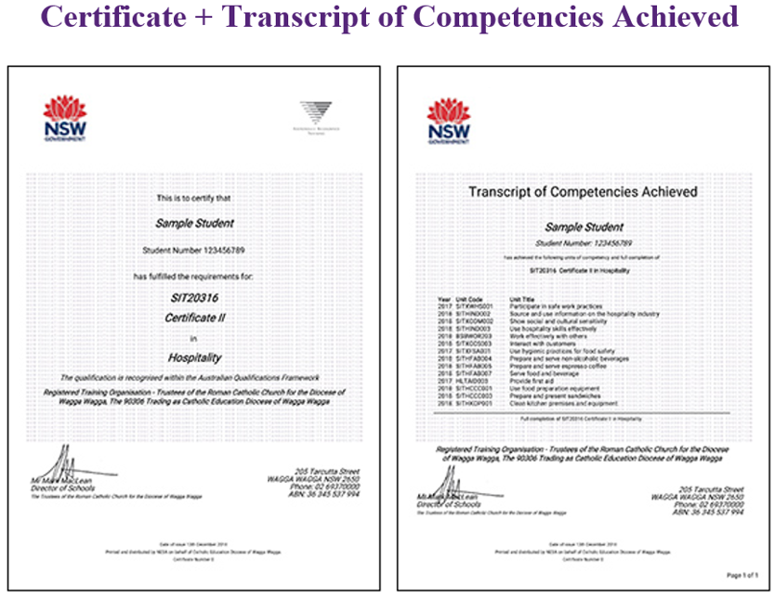
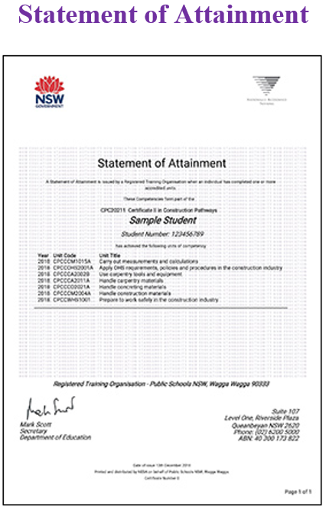
Year 10 Subject Selection for Stage 6
VET Credentials
Notes:
An AQF Certificate is awarded to students in Vocational Education and Training (VET) courses who successfully complete all requirements of an Australian Qualifications Framework (AQF) Certificate.
A Statement of Attainment is issued to students in VET courses who partially complete the requirements of an AQF Certificate.
http://educationstandards.nsw.edu.au/wps/portal/nesa/11-12/hsc/results-certificates/vet-qualifications

Slide 33
HSC Credentials

Slide 34
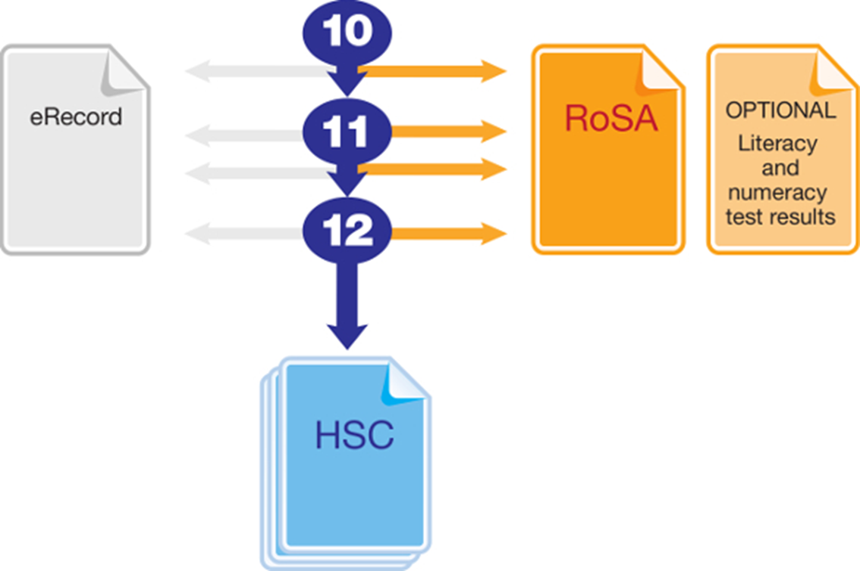
Year 10 Subject Selection for Stage 6
Record of School Achievement
Notes:
Eligible students who leave school before receiving their Higher School Certificate (HSC) will receive the NSW Record of School Achievement (RoSA).
The RoSA is a cumulative credential in that it allows students to accumulate their academic results until they leave school.
The RoSA records completed Stage 5 and Preliminary Stage 6 courses and grades, participation in any uncompleted Preliminary Stage 6 courses and HSC results for students who have not completed their HSC
It is of specific use to students leaving school prior to the HSC.
https://educationstandards.nsw.edu.au/wps/portal/nesa/11-12/leaving-school/record-of-school-achievement

Slide 35
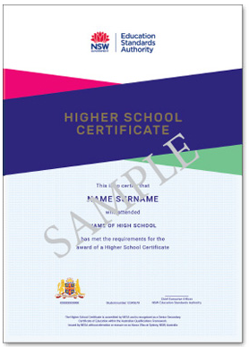
Year 10 Subject Selection for Stage 6
NSW HSC Testamur
Notes:
The HSC testamur shows that a student is eligible for the Higher School Certificate. It includes the student's name, school and date of the award.
https://educationstandards.nsw.edu.au/wps/portal/nesa/11-12/hsc/results-certificates/results-documentation

Slide 36
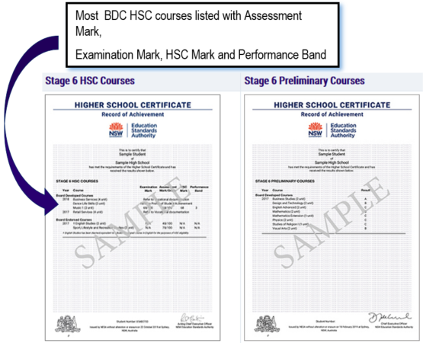
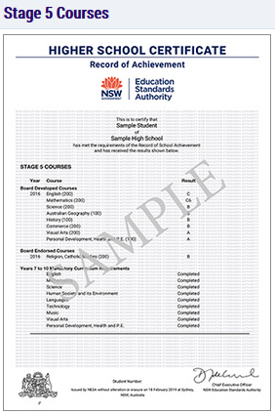
Year 10 Subject Selection for Stage 6
HSC Record of Achievement
All Preliminary and Stage 5 courses will be on separate certificates
Notes:
The Higher School Certificate (HSC) Record of Achievement (RoA) includes students' Year 12 HSC (Stage 6) results, Year 11 (Preliminary Stage 6) grades and, if applicable, Year 10 (Stage 5) grades. Results for each Stage appear on separate pages. This provides formal recognition of students' senior secondary school achievements.
Assessment mark: School-based assessment tasks measure performance in a wider range of course outcomes than can be tested in an external examination. Students are required to complete a number of assessment tasks for most courses, which may include tests, written or oral assignments, practical activities, fieldwork and projects. Schools submit an HSC assessment mark based on performance in these tasks for every student who completed an HSC course that has a compulsory external examination. NESA puts these assessment marks through a process of moderation to allow a fair comparison of marks in each course across different schools.
Examination mark: The examination mark for each course shows the student's performance in NESA's HSC examination for that course. The examination in most courses consists of a written paper and, for some courses, may include speaking and listening examinations, practical examinations, or major works that are submitted for external marking. Each student's achievement is assessed and reported against set standards of performance.
HSC mark: The HSC mark in courses with a compulsory external examination is a 50:50 combination of a student's external examination mark and their school-based assessment mark for the course. In courses with optional examinations, the HSC mark is drawn from the external examination only.
https://educationstandards.nsw.edu.au/wps/portal/nesa/11-12/hsc/results-certificates/results-documentation

Slide 37
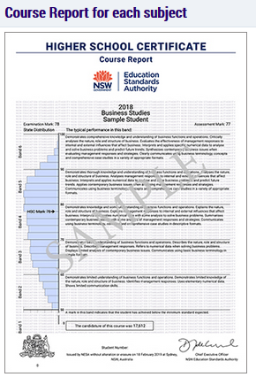
Year 10 Subject Selection for Stage 6
HSC Course Report
Notes:
Performance band: A student's HSC mark is reported against standards described in the performance bands. For each 2-unit course there are six performance bands, where the highest achievement is Band 6 (90–100 marks) and where the minimum standard expected is Band 2 (50–60 marks). For 1-unit extension courses, four performance bands, E1–E4 are used to report student achievement. Each performance band describes what a student working at that level typically knows, understands and can do. Some performance band descriptions are abridged on the Course Reports.

Slide 38
Year 10 Subject Selection for Stage 6
More Information
www.educationstandards.nsw.edu.au
www.uac.edu.au
Notes:
http://educationstandards.nsw.edu.au/wps/portal/nesa/11-12/hsc/subject-selection

Slide 39
HSC Marks

Slide 40
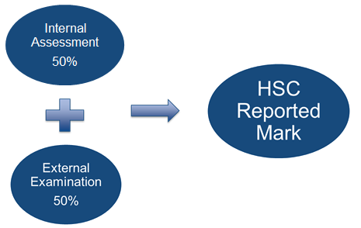
Year 10 Subject Selection for Stage 6
How is the HSC Mark Determined?

Slide 41
Australian Tertiary Admission Rank

Slide 42
Year 10 Subject Selection for Stage 6
Australian Tertiary Admission Rank
The Australian Tertiary Admission Rank (ATAR):
is for students wishing to gain a place at a university
is a rank NOT a mark
provides information about how a student performs overall in relation to other students
Notes:
UAC will only consider Board Developed Courses in the calculation of the ATAR.
The ATAR provides the discrimination required by universities for the selection process.

Slide 43
Year 10 Subject Selection for Stage 6
Other Considerations
What do I want for my future?
What ‘pathway’ best suits me?
Ask for advice from:
teachers
parents
Year adviser
careers adviser
Notes:
http://educationstandards.nsw.edu.au/wps/portal/nesa/11-12/hsc/subject-selection

