Slide 1
Year 8 Subject Selection
for Stage 5 (Year 9 – 2018)
Year 8 parent meeting
Wednesday 26 July 2017

Slide 2
Year 8 Subject Selection for Stage 5
What we will be talking about …
Considerations for your study
The course of study in Stage 5
Choices you can make
NESA rules
Our expectations from you as a student of this school

Slide 3
Year 8 Subject Selection for Stage 5
Course Selection Considerations …
Abilities and strengths
Interests/Motivation/enjoyment
Career aspirations and needs
Syllabus requirements - Practical/Major work components
Subject combinations
Other commitments outside of study
Notes:
Abilities - choose subjects where you are capable of doing well.
Interests/Motivation- choose subjects that interest you.
Career aspirations and needs - keep in mind future career paths but be realistic about choices.
Syllabus Requirements – be mindful of how many practical works and major works are required for your pattern of study and the timing of submission.
Subject combinations - do the subjects complement each other?
Other commitments - when choosing subjects, it its important to balance study with outside commitments and influences such as work, sport and family.
http://educationstandards.nsw.edu.au/wps/portal/nesa/11-12/hsc/subject-selection

Slide 4
Year 8 Subject Selection for Stage 5
Stage 5 Courses of study …
Is moving to more specialised choices of study in some areas.
Leads towards Stage 6 and the HSC.
Focuses on growing students to be independent learners who can think and act for themselves.
Refines literacy and numeracy skills to cope more independently.
Moves closer to a more adult approach to learning giving students more individual responsibility.
Leads to credentials that highlight records of achievement from NESA in Year 10, 11 and 12
Notes:
http://educationstandards.nsw.edu.au/wps/portal/nesa/11-12/hsc/subject-selection

Slide 5
Year 8 Subject Selection for Stage 5
Stage 5 Course Structure …
Students must study the mandatory subjects of …
English
Mathematics
Science
Human Society and its Environment - History and Geography
PDHPE / Sport
Notes:
http://ace.bostes.nsw.edu.au/ace-8064
http://educationstandards.nsw.edu.au/wps/portal/nesa/11-12/hsc/subject-selection

Slide 6
Students in Stage 5 must choose at least TWO elective subjects …
Child studies
Commerce
Dance
Design and Technology
Drama
Food Technology
Geography Elective
History Elective
Industrial Technology Timber
Information and Software Tec
Languages – French, Italian, Spanish
Music
Photographic and Digital Media
Physical activity and Sport
Textiles Technology
Visual Arts Visual Design
Work Education
Notes:
Students may accumulate course units towards the HSC for a period of up to 5 years.
Students may choose to undertake this ‘pathway’ approach for a variety of reasons including:
commitments outside school - part time work, elite sportsperson etc.
apprenticeship or traineeship
acceleration
repeating
http://ace.bostes.nsw.edu.au/ace-8036
http://educationstandards.nsw.edu.au/wps/portal/nesa/11-12/hsc/subject-selection

Slide 7
Year 8 Subject Selection for Stage 5
Other choices may include …
Vocational Education qualifications of …
Business Services
Retail Services
In addition …
Students may choose to study a language at the Saturday School of Community Languages on a Saturday morning.
Notes:
English is mandatory for the HSC.
English Studies and Mathematics Standard 1 are Board Developed Courses with an optional HSC examination. Students who choose English Studies and/or Mathematics Standard 1, but wish to receive an ATAR, must undertake the optional examination.
Extension course are not separate subjects. E.g. Advanced English (2 units) + Extension 1 (1 unit) + Extension 2 (1 unit) = 4 units but only 1 subject.
At most, 6 units of courses in Science can be included in the pattern of study for Year 11. However, from 2019 Year 12, this increases to 7 units of Science, to allow for the study of Science Extension.
http://ace.bostes.nsw.edu.au/ace-8005

Slide 8
Year 8 Subject Selection for Stage 5
Satisfactory Completion of a Course …
Students must …
follow the course developed or endorsed by NESA;
apply themselves with diligence and sustained effort to the set tasks and experiences provided in the course by the school, and
achieve some or all of the course outcomes.
Notes:
http://ace.bostes.nsw.edu.au/ace-8019
https://studentsonline.nesa.nsw.edu.au/go/seniorstudy/hsc_rules_and_procedures/

Slide 9
Year 8 Subject Selection for Stage 5
Our Expectations
Students must:
Attend class for all periods of study.
Complete all classwork and assessment tasks.
Try hard all of the time and make a serious attempt at all work tasks.
Complete homework tasks and study hard.
REACH high in all that you do!
Notes:
http://ace.bostes.nsw.edu.au/ace-8020
http://ace.bostes.nsw.edu.au/ace-8026

Slide 10
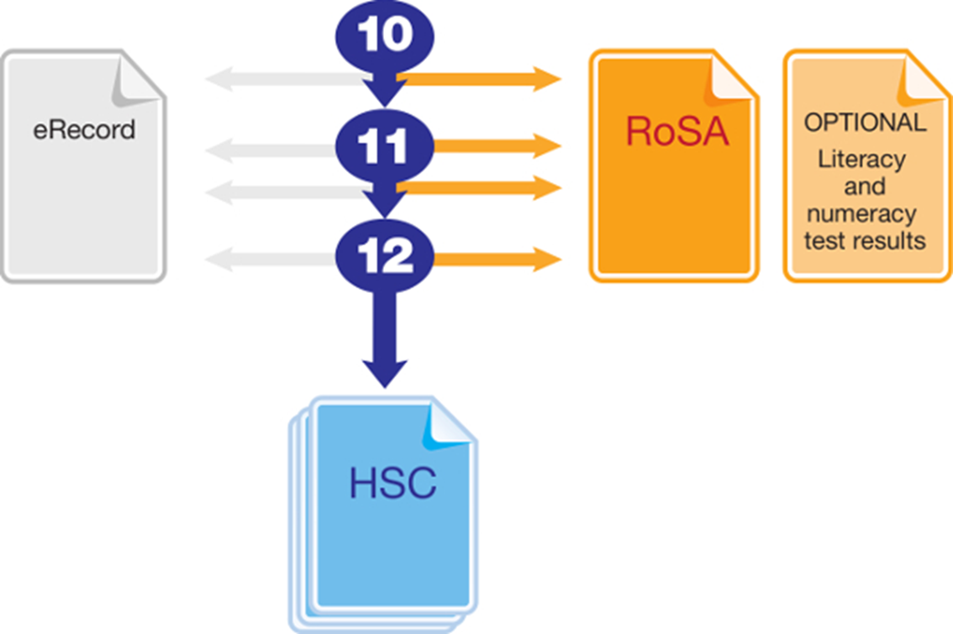
Year 8 Subject Selection for Stage 5
Record of School Achievement
Notes:
Eligible students who leave school before receiving their Higher School Certificate (HSC) will receive the NSW Record of School Achievement (RoSA).
The RoSA is a cumulative credential in that it allows students to accumulate their academic results until they leave school.
The RoSA records completed Stage 5 and Preliminary Stage 6 courses and grades, participation in any uncompleted Preliminary Stage 6 courses and HSC results for students who have not completed their HSC
It is of specific use to students leaving school prior to the HSC.
http://educationstandards.nsw.edu.au/wps/portal/nesa/11-12/leaving-school/record-of-school-achievement
https://studentsonline.bostes.nsw.edu.au/go/seniorstudy/

Slide 11
Year 8 Subject Selection for Stage 5
Other Considerations …
What do I want for my future?
What ‘pathway’ best suits me?
Ask for advice from:
teachers
parents
Year adviser
careers adviser
Notes:
http://educationstandards.nsw.edu.au/wps/portal/nesa/11-12/hsc/subject-selection

Slide 12
Key Features of Electives
offered at
Liverpool Girls’ High School

Slide 13
Year 8 Subject Selection for Stage 5
Creative and Performing Arts - CAPA
MUSIC
Students will learn about …
Students will study the concepts of music (duration, pitch, dynamics and expressive techniques, tone colour, texture and structure) through the learning experiences of performing, composing and listening, within the context of a range of styles, periods and genres such as Music of a Culture, Theatre Music, Music and Technology, Australian Popular Music, The Music of Gospel, Soul, Funk and Motown and Music for Film, TV and Multimedia.
The Elective course requires the study of the compulsory topic Australian Music, as well as Baroque Music and Classical Music.

Slide 14
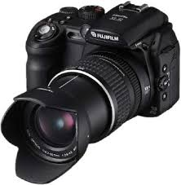
Year 8 Subject Selection for Stage 5
PHOTOGRAPHIC AND DIGITAL MEDIA
Students will explore:
Wet photography (darkroom)
Digital photography - Computer-generated images using Adobe Photoshop and other computer programs.
Video and animation
Students will use a range of materials and techniques, be required to produce a portfolio and keep a journal. They may use their own cameras but will have access to school cameras.
Students learn to investigate and respond to a wide range of photographic and digital media artists and works in making, critical and historical studies.

Slide 15
Year 8 Subject Selection for Stage 5
VISUAL ARTS
In Visual Arts students will learn about a range of art practices including;
Painting and drawing
Sculpture
Ceramics
Photography and digital media
Printmaking
Art Wearable
Students will need to purchase a Visual Arts Diary to record their art making process.

Slide 16
Year 8 Subject Selection for Stage 5
VISUAL DESIGN
Students learn about the Visual Design practices of:
Web designers
Architects
Commercial and Industrial Designers
Space
Light and Sound Designers
Graphic Designers
Fashion, Accessory and Textile Designers
Interior Designers
Students will need to purchase a Visual Arts Diary to record their art making process.

Slide 17
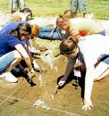
Year 8 Subject Selection for Stage 5
History Elective …
In Years 9 and 10 students who are interested in world history and would like to learn about it in less traditional ways can choose History Elective.
Assessment may include: writing drama scripts, making picture books or learning what is fact and what is entertainment through the study of historical films and various technology inspired learning activities.

Slide 18
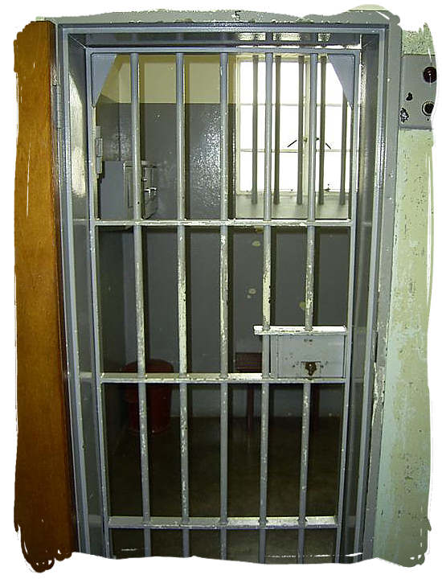
Year 8 Subject Selection for Stage 5
Topics will include:
Ancient Societies of China and Greece
Crime Investigation Unit- Unsolved History Mysteries (Jack The Ripper)
Herstory- Famous women from various cultural backgrounds
Genocide- An ancient or modern phenomenon?
History through popular culture- the study of art, film,
song and literature

Slide 19
Year 8 Subject Selection for Stage 5
Languages – French, Italian, Spanish
This is an elective course, which will continue into Year 10. You will begin an audio visual course and learn to communicate in your chosen language through use of information technology, CDs, apps, games and role play. Culture will also be explored and experienced as an important aspect of learning the language.

Slide 20
Year 8 Subject Selection for Stage 5
Topics studied include:
Personal identity
Family and neighbourhood
Weekend activities
Like/dislikes
School
Where the language is spoken in the world
Culture, food and festivals
Fashion
Travel
How the language works

Slide 21
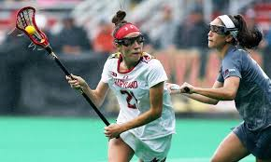
Year 8 Subject Selection for Stage 5
PDHPE
Physical Activity and Sports Studies
The PASS course is suited to students who are highly interested in how and why the body moves. The practical aspects of this course are designed to coincide with the content being taught during theory lessons. Students will be learning through experiences in physical activity and sport movement application.

Slide 22
Year 8 Subject Selection for Stage 5
Topics include:
The body in action
Games from around the world
Event management
Sports coaching
Fitness

Slide 23
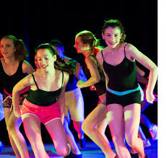
Year 8 Subject Selection for Stage 5
Dance
Dance is designed for students to experience and
understand dance as an artform. Dance has three
core components that make up the course:
Performance: Development of individual technical proficiency in modern/contemporary dance technique.
Composition: Understanding the elements of composition and create your own dance pieces.
Appreciation: Appreciation requires you to observe and critically analyse work from famous artists/choreographers as well your own and your peers.

Slide 24
Year 8 Subject Selection for Stage 5
Topics include:
Modern Jazz
Hip-hop/Funk
Traditional &Cultural Dance
Modern/Contemporary Dance
Musical Theatre/Broadway
Indigenous Australian Dance

Slide 25
Year 8 Subject Selection for Stage 5
Social Sciences …
Commerce
Commerce provides the knowledge, skills, understanding and values that form the foundation on which young people make sound decisions on consumer, financial, business, legal and employment issues.
Units: Consumer Choice, Personal Finance, Law and Society, Employment Issues Investing, Promoting and Selling, Towards Independence, Political Involvement, and Running a Business
Geography Elective
Geography Elective emphasises the physical, social, cultural, economic and political influences on people, places and environments, from local to global scales. It also emphasises the important interrelationships between people and environments through the investigation of contemporary geographical issues and their management. The wellbeing of societies and environments depends on the quality of interactions between people and the natural world.

Slide 26
Year 8 Subject Selection for Stage 5
Work Education
Students will develop an understanding of employability skills that will assist them to achieve the flexibility required for the workplaces of today and of the future. Students will learn to successfully plan and manage life transitions including post-school pathways.

Slide 27
Year 8 Subject Selection for Stage 5
Technological and applied studies (TAS)
Child Studies
Students will focus on social, environmental, genetic and cultural factors that influence pre-natal development and a child’s sense of wellbeing and belonging.
Students will identify, create and evaluate solutions to enhance child wellbeing. Course fee: $15.00
Design and Technology
Students will research and investigate existing solutions, analyse data and information in order to create innovative solutions to a range of design projects that are related to real-life contexts. Course fee: $40.00

Slide 28
Year 8 Subject Selection for Stage 5
Food Technology
Students will explore food-related issues, nutrition principles and engage in a range of practical experiences. Students will identify the relationships between food habits, lifestyles and other factors that affect the health and wellbeing of Australians. Course fee: $55.00
Information and Software Technology
Students will engage in processes of analysing, designing, producing, testing, documenting, implementing and evaluating information and software technology-based solutions. Practical projects will assist students in developing creative, critical and meta-cognitive thinking skills.
Textiles and Design
Students will develop knowledge about the properties, performance and uses of textiles. Textiles projects will enable students to developing skills in the manipulation and use of a range of textile materials, equipment and techniques. Course fee: $30.00

Slide 29
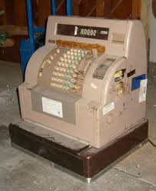
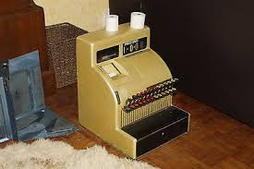
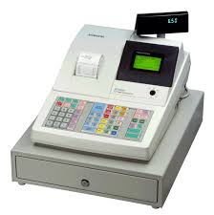
Year 8 Subject Selection for Stage 5
Vocational Education – VET …
Year 9- Retail Services SIR10116 Certificate I in Retail Services
This qualification reflects the role of individuals who complete basic workplace tasks such as customer service, merchandising and operating the register. It provides a pathway to work in a variety of retail industry sectors both small and large.
Year 10- Business Services BSB10115 Certificate I in Business Services
The Certificate I in Business allows you to develop and enhance an array of skills required for success in the workplace. Learn to effectively communicate with those around you and organise your time for efficiency. Develop valuable computing and keyboard skills and enhance your knowledge of workplace health and safety to better contribute to the wellbeing of yourself and others.

