Slide 1


Year 10 Subject Selection
for Stage 6 (Year 11 – 2018)
Year 10 parent meeting
Wednesday 26 July 2017

Slide 2
Year 10 Subject Selection for Stage 6
Course Selection Considerations
    Abilities
    Interests/Motivation
    Career aspirations and needs
    Syllabus requirements - Practical/Major work components
    Subject combinations
    Other commitments
Notes:
Abilities - choose subjects where you are capable of doing well.
Interests/Motivation- choose subjects that interest you.
Career aspirations and needs - keep in mind future career paths but be realistic about choices.
Syllabus Requirements – be mindful of how many practical works and major works are required for your pattern of study and the timing of submission.
Subject combinations - do the subjects complement each other?
Other commitments - when choosing subjects, it its important to balance study with outside commitments and influences such as work, sport and family.
http://educationstandards.nsw.edu.au/wps/portal/nesa/11-12/hsc/subject-selection

Slide 3
Year 10 Subject Selection for Stage 6
The Higher School Certificate
is the culmination of a student’s school career
is the highest educational award that can be achieved at secondary school in New South Wales
reports student achievement in terms of a standard achieved in individual courses
presents a profile of student achievement across a broad range of subjects
Notes:
http://educationstandards.nsw.edu.au/wps/portal/nesa/11-12/hsc/subject-selection

Slide 4
Year 10 Subject Selection for Stage 6
HSC Course Structure
All courses in the HSC have a unit value
Most courses are 2 units which equates to 120 hours of study and an HSC result out of 100
  Some courses are 1 unit. This is equivalent to 60 hours of study and a HSC result out of 50
Many 1 unit courses are extension courses, enabling 3 or 4 units of a course to be studied
Notes:
http://ace.bostes.nsw.edu.au/ace-8064
http://educationstandards.nsw.edu.au/wps/portal/nesa/11-12/hsc/subject-selection

Slide 5
Year 10 Subject Selection for Stage 6
Requirements for the HSC
Year 11
minimum of 12 units
students must satisfactorily complete the Year 11 course before commencing the corresponding Year 12 course
Year 12
minimum of 10 units
Notes:
Students may accumulate course units towards the HSC for a period of up to 5 years.
Students may choose to undertake this ‘pathway’ approach for a variety of reasons including:
commitments outside school - part time work, elite sportsperson etc.
apprenticeship or traineeship
acceleration
repeating
http://ace.bostes.nsw.edu.au/ace-8036
http://educationstandards.nsw.edu.au/wps/portal/nesa/11-12/hsc/subject-selection

Slide 6
Year 10 Subject Selection for Stage 6
Requirements for the HSC
Both the Year 11 and Year 12 pattern of study must include:
2 units of compulsory English
at least 6 units of Board Developed Courses
at least 3 courses of 2 units value or greater
at least 4 subjects (including English)
a maximum of 6 units of Science may be included in the Year 11 pattern of study.
from 2019, a maximum of 7 units of Science may be included in the Year 12 pattern of study.
Notes:
English is mandatory for the HSC.
English Studies and Mathematics Standard 1 are Board Developed Courses with an optional HSC examination. Students who choose English Studies and/or Mathematics Standard 1, but wish to receive an ATAR, must undertake the optional examination.
Extension course are not separate subjects. E.g. Advanced English (2 units) + Extension 1 (1 unit) + Extension 2 (1 unit) = 4 units but only 1 subject.
At most, 6 units of courses in Science can be included in the pattern of study for Year 11. However, from 2019 Year 12, this increases to 7 units of Science, to allow for the study of Science Extension.
http://ace.bostes.nsw.edu.au/ace-8005

Slide 7
Year 10 Subject Selection for Stage 6
Types of HSC Courses
Board Developed Courses | Board Endorsed Courses
HSC examination except for: optional examination in English Studies and Mathematics Standard 1 and VET Framework courses All Life Skills courses | No HSC examination – school-based assessment only
May be included in the calculation of a student’s Australian Tertiary Admission Rank (ATAR). | Not included in the calculation of a student’s Australian Tertiary Admission Rank (ATAR).
Includes some Vocational Education and Training (VET) courses. | Includes some Vocational Education and Training (VET) courses.
Includes Life Skills courses.
Notes:
Board Developed Courses are developed by NESA and all students in the state study the same course content and complete the same HSC examination. These courses may contribute to the calculation of a student’s ATAR . Life Skills Courses do not have an examination and are not included in the calculation of an ATAR.
Board Endorsed Courses have syllabuses endorsed by NESA to cater for a wide candidature in areas of specific need not served by Board Developed Courses. These courses may offer an alternative career path for students.
http://ace.bostes.nsw.edu.au/ace-6001
http://ace.bostes.nsw.edu.au/ace-6005

Slide 8
Year 10 Subject Selection for Stage 6
Board Developed Courses and the ATAR
Category A Courses | Category B Courses
May be included in the calculation of a student’s Australian Tertiary Admission Rank (ATAR) | No more than 2 units of Category B courses can be included in the calculation of a student’s ATAR
Compulsory HSC Examination for most courses | Optional HSC examination for some courses
 | Include VET Curriculum Framework courses and have compulsory work placement.
Notes:
It is the responsibility of the Universities Admission Centre (UAC) to determine if a course can be included in the calculation of the ATAR.
Category A Courses have academic rigour and depth of knowledge to provide background for tertiary studies. Examples include Biology and Geography.
Category B Courses - no more than two units of Category B courses can be included in the ATAR calculation. Examples include Human Services and Hospitality.
Course category listings available at the UAC Website: http://www.uac.edu.au/documents/undergraduate/HSCcourses.pdf

Slide 9
Year 10 Subject Selection for Stage 6
SATISFACTORY COMPLETION OF A COURSE
Students must:
  follow the course developed or endorsed by NESA
  apply themselves with diligence and sustained effort to the set tasks and experiences provided in the course by the school, and
  achieve some or all of the course outcomes
  VET Board Developed Courses require students to complete mandatory work placement – these courses have fees attached that need to be paid at the beginning of the course
Notes:
http://ace.bostes.nsw.edu.au/ace-8019
https://studentsonline.nesa.nsw.edu.au/go/seniorstudy/hsc_rules_and_procedures/

Slide 10
Year 10 Subject Selection for Stage 6
ADDITIONAL COMPLETION REQUIREMENTS FOR HSC COURSES
Students must:
  complete HSC assessment tasks that contribute in excess of 50 per cent of available marks in courses where internal assessment marks are submitted, and
  sit for and make a serious attempt at any requisite Higher School Certificate examinations for a course
  have completed the “All my own work” modules
Notes:
http://ace.bostes.nsw.edu.au/ace-8020
http://ace.bostes.nsw.edu.au/ace-8026

Slide 11
HSC Credentials

Slide 12
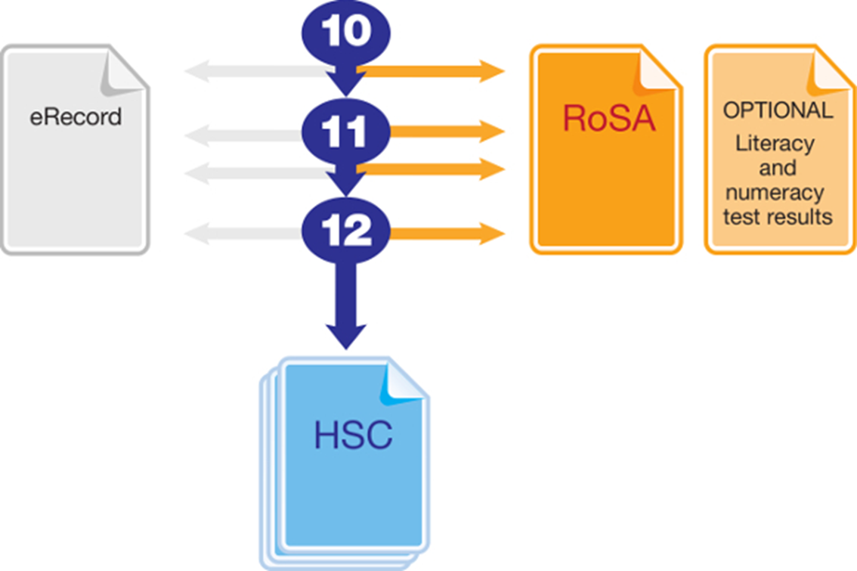
Year 10 Subject Selection for Stage 6
Record of School Achievement
Notes:
Eligible students who leave school before receiving their Higher School Certificate (HSC) will receive the NSW Record of School Achievement (RoSA).
The RoSA is a cumulative credential in that it allows students to accumulate their academic results until they leave school.
The RoSA records completed Stage 5 and Preliminary Stage 6 courses and grades, participation in any uncompleted Preliminary Stage 6 courses and HSC results for students who have not completed their HSC
It is of specific use to students leaving school prior to the HSC.
http://educationstandards.nsw.edu.au/wps/portal/nesa/11-12/leaving-school/record-of-school-achievement
https://studentsonline.bostes.nsw.edu.au/go/seniorstudy/

Slide 13
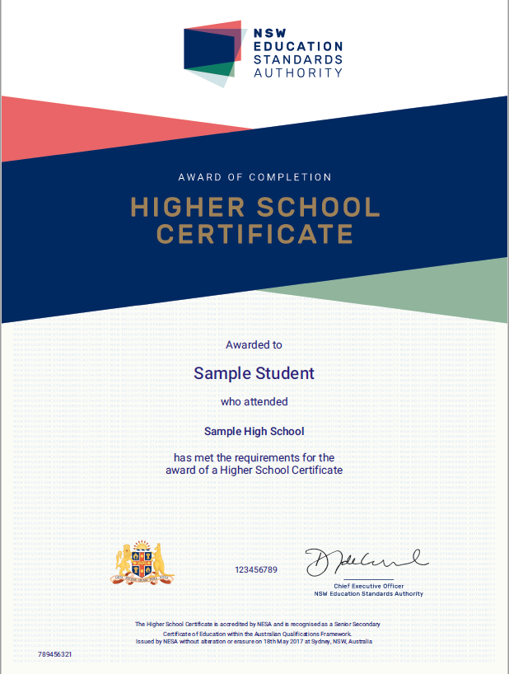
Year 10 Subject Selection for Stage 6
NSW HSC Testamur
not final version
sample only
Notes:
The HSC testamur is awarded to students who have fulfilled all eligibility requirements for the HSC.
http://educationstandards.nsw.edu.au/wps/portal/nesa/11-12/hsc/results-certificates/results-documentation

Slide 14
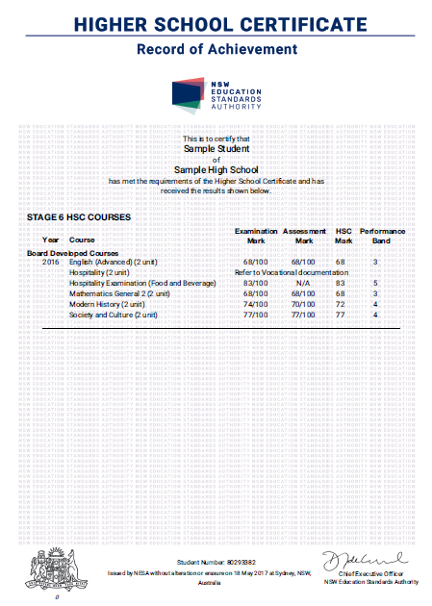
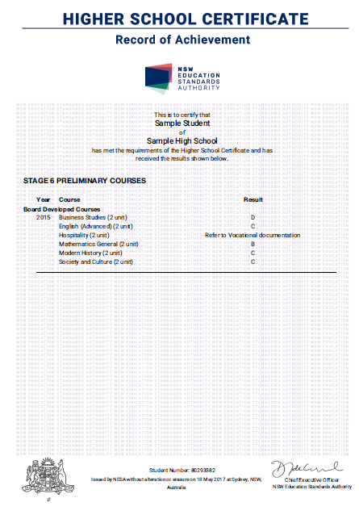
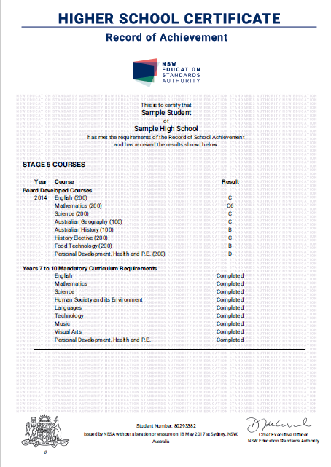
Year 10 Subject Selection for Stage 6
HSC Record of Achievement
Most BDC HSC courses listed with Assessment Mark,
Examination Mark, HSC Mark and Performance Band
All Preliminary and Stage 5 courses will be on separate certificates

Slide 15
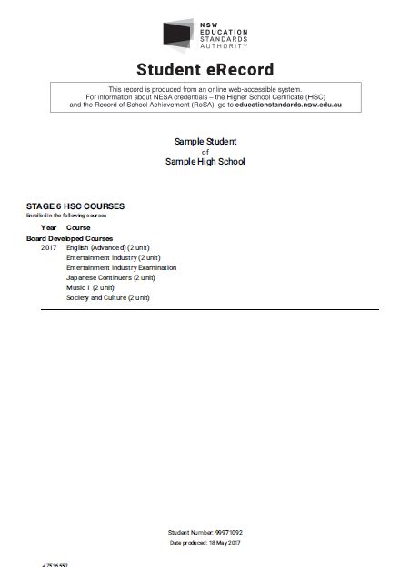
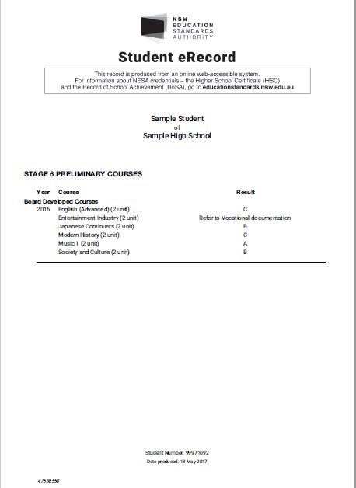
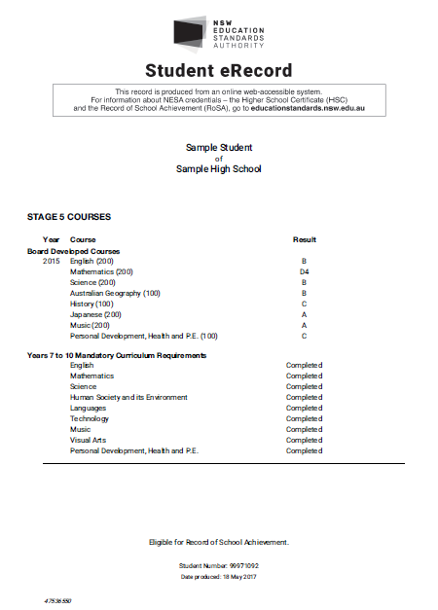
Year 10 Subject Selection for Stage 6

Slide 16
HSC Marks

Slide 17
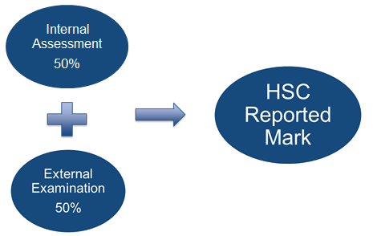
Year 10 Subject Selection for Stage 6
How is the HSC Mark Determined?
Notes:
Internal Assessment. Why is it important?
Contributes 50% of HSC mark
Is a course completion requirement
May be used to calculate an HSC mark in the case of a successful Illness/Misadventure appeal
School assessment marks in each course are moderated to place them on a state-wide scale.
Examination marks aligned to the standards-based reporting scale contribute 50% of HSC mark.
Some courses have practical examinations and/or submitted works or projects in addition to the written HSC examination.
Written examinations are held in October and November each year.
For each course with a compulsory examination, reported information includes:
Examination mark aligned to the standards-based reporting scale
Moderated assessment mark
HSC mark
Corresponding Performance Band
http://www.boardofstudies.nsw.edu.au/hsc-results/understanding.html

Slide 18
Australian Tertiary Admission Rank

Slide 19
Year 10 Subject Selection for Stage 6
Australian Tertiary Admission Rank
The Australian Tertiary Admission Rank (ATAR):
    is for students wishing to gain a place at a university
    is a rank NOT a mark
    provides information about how a student performs overall in relation to other students
Notes:
UAC will only consider Board Developed Courses in the calculation of the ATAR.
The ATAR provides the discrimination required by universities for the selection process.

Slide 20
Key Features of Courses
offered at
Liverpool Girls’ High School

Slide 21
Year 10 Subject Selection for Stage 6
Creative and Performing Arts (CAPA)
Music 1 (Cat A)
In the Year 11 and Year 12 courses, students will study the concepts of music through the learning experiences of performance, composition, musicology and aural within the context of a range of styles, periods and genres.
Performance is a mandatory requirement for the Stage 6 Music 1 course.

Slide 22

Year 10 Subject Selection for Stage 6
COURSE CONTENT
Students will study three topics in each year of the course.
Topics studied include:
  Music for Small Ensembles;
  Rock Music;
  Music for Multimedia;
  Film and TV;
  Popular Music, and
  An Instrument and Its Repertoire and Music of the 20th and 21st Centuries.

Slide 23

Year 10 Subject Selection for Stage 6
Visual Arts (Cat A)
Visual Arts involves students in artmaking, art criticism and art history. Students develop their own artworks, culminating in a ‘Body of Work’ in the Year 12 course. Students critically and historically investigate artworks, critics, historians and artists from Australia as well as those from other cultures, traditions and times.
The Year 11 course is broadly focused, while the Year 12 course provides for deeper and more complex investigations. While the course builds on Visual Arts courses in Stages 4 and 5, it also caters for students with more limited experience in Visual Arts.
This course is split into two even halves of Theory and Practical. Each component is worth 50% of a students overall mark.

Slide 24
Year 10 Subject Selection for Stage 6
Photography and Visual Design (Cat B)
Photography, Video and Digital Imaging offers students the opportunity to explore contemporary artistic practices that make use of Photography, Video and Digital Imaging. These fields of artistic practice resonate within students’ experience and understanding of the world and are highly relevant to contemporary ways of interpreting the world. The course offers opportunities for investigation of one or more of these fields and develops students’ understanding and skills, which contribute to an informed critical practice.
The Visual Design section of the course provides students with opportunities to explore the links between Art and Design by designing and making images and objects in which aesthetic qualities and symbolic meanings are as important as utilitarian function. It encourages students to explore the practices of graphic, wearable, product and interior/exterior designers in contemporary societies and promotes imaginative and innovative approaches to design within the context of the Australian environment and culture.

Slide 25

Year 10 Subject Selection for Stage 6
English
English is MANDATORY.
  You must satisfactorily complete a minimum of TWO units of English
  2 units of English must be counted in your ATAR.
  It is possible to attempt THREE units of English in Year 11 and FOUR units in Year 12.
Notes:
English Standard is designed for students to increase their expertise in English to enhance their personal, educational, social and vocational lives. The English Standard course provides students with the opportunity to analyse, study and enjoy a breadth and variety of English texts to become confident and effective communicators.
English Advanced is designed for students who have a particular interest and ability in the subject and who desire to engage with challenging learning experiences that will enrich their personal, intellectual, academic, social and vocational lives. They study challenging written, spoken, visual, multimodal and digital texts that represent and reflect a changing global world.
English EAL/D addresses the needs of a specific group of students and shares the overall aim and rationale of English. When presented at the HSC, the English EAL/D course will satisfy NESA requirements for the study of English. The English EAL/D course is designed for students to become proficient in English to enhance their personal, educational, social and vocational lives. The course provides students with the opportunity to analyse, study and enjoy a breadth and variety of English texts to become confident and effective communicators.
English Studies is distinctive in its focus on the development of students’ language, literacy and literary skills. It is designed to provide students with opportunities to become competent, confident and engaged communicators and to study and enjoy a breadth and variety of texts in English. English Studies focuses on supporting students to refine their skills and knowledge in English and consolidate their English literacy skills to enhance their personal, educational, social and vocational lives. English Studies is a Board Developed Course, with an optional HSC examination, for those students wanting to enter university.
English Extension 1 provides students who undertake Advanced English and are accomplished in their use of English with the opportunity to extend their use of language and self-expression in creative and critical ways.
Students should seek advice from the English Faculty regarding their suitability for a particular course.
http://syllabus.nesa.nsw.edu.au/stage-6/
http://syllabus.nesa.nsw.edu.au/english/

Slide 26

Year 10 Subject Selection for Stage 6
You must choose either:
English Standard (Category A) OR
English Advanced (Category A) OR
English EAL/D (Category A) OR
English Studies (Category B)

Slide 27
Year 10 Subject Selection for Stage 6
English Advanced (New Course) (Cat A)
  2 unit English Course
  More academically demanding than Standard English
  Has a compulsory Shakespeare Study.
English Standard (New Course) (Cat A)
  2 unit English Course
  Is suitable for the majority of English Students.
English EAL/D (New Course) (Cat A)
  2 unit English Course designed for students who have educated using English for five years or less at the beginning of Year 11.
  Is accepted by most universities for almost all courses.

Slide 28
Year 10 Subject Selection for Stage 6
English Studies (New Course) (Cat B)
  2 Unit English Course
  Is aimed at student seeking an alternative to Standard English and intending to go straight into vocational education or employment.
  If students require an ATAR it is recommended that they complete the English Standard Course.
English Extension 1 and 2 (New Courses) (Cat A)
  1 Unit subjects.
  Extension 1 can ONLY be completed by students who are completing the Advanced English Course, in both year 11 and year 12.
  Extension 2 can ONLY be completed in Year 12 by students who are completing Advanced English and Extension 1 English.
Notes:
English Standard is designed for students to increase their expertise in English to enhance their personal, educational, social and vocational lives. The English Standard course provides students with the opportunity to analyse, study and enjoy a breadth and variety of English texts to become confident and effective communicators.
English Advanced is designed for students who have a particular interest and ability in the subject and who desire to engage with challenging learning experiences that will enrich their personal, intellectual, academic, social and vocational lives. They study challenging written, spoken, visual, multimodal and digital texts that represent and reflect a changing global world.
English EAL/D addresses the needs of a specific group of students and shares the overall aim and rationale of English. When presented at the HSC, the English EAL/D course will satisfy NESA requirements for the study of English. The English EAL/D course is designed for students to become proficient in English to enhance their personal, educational, social and vocational lives. The course provides students with the opportunity to analyse, study and enjoy a breadth and variety of English texts to become confident and effective communicators.
English Studies is distinctive in its focus on the development of students’ language, literacy and literary skills. It is designed to provide students with opportunities to become competent, confident and engaged communicators and to study and enjoy a breadth and variety of texts in English. English Studies focuses on supporting students to refine their skills and knowledge in English and consolidate their English literacy skills to enhance their personal, educational, social and vocational lives. Students studying English Studies may elect to undertake an optional HSC examination. The examination mark may be used by the Universities Admissions Centre (UAC) to contribute to the student’s Australian Tertiary Admission Rank (ATAR).
English Extension 1 provides students who undertake Advanced English and are accomplished in their use of English with the opportunity to extend their use of language and self-expression in creative and critical ways.
English Extension 2 consists of a Major Work undertaken over 60 indicative hours of study. This course provides students with the opportunity to apply and extend research skills developed in the English Extension Year 11 course to their own extensive investigation and develop autonomy and skills as a learner and composer. English Extension 2 develops independent and collaborative learning skills and higher-order critical thinking that are essential at tertiary levels of study and in the workplace. The course is designed for students who are independent learners with an interest in literature and a desire to pursue specialised study of English.
Students should seek advice from the English Faculty regarding their suitability for a particular course.
http://syllabus.nesa.nsw.edu.au/stage-6/
http://syllabus.nesa.nsw.edu.au/english/

Slide 29
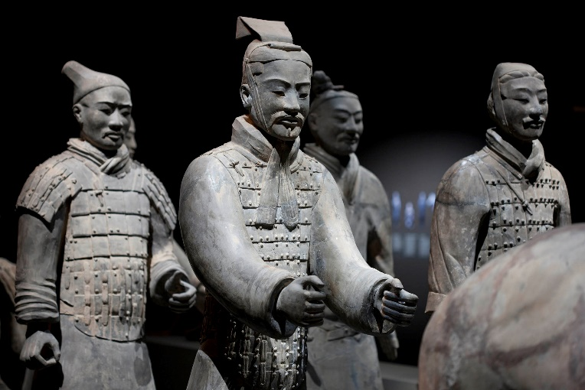
Year 10 Subject Selection for Stage 6
History
Ancient History (Cat A) (New Course)
The study of Ancient History in Stage 6 enables students to:
  develop knowledge and understanding of the ancient world, historical skills, and values and attitudes essential to an appreciation of the ancient world
  develop a lifelong interest in the study of history
  prepare for active and informed citizenship in the contemporary world.

Slide 30
Year 10 Subject Selection for Stage 6
Topics studied include:
  The nature of Ancient History - archaeology and methods used to reconstruct the past: The Iceman
  Case Studies - Thera/Santorini, Tutankhamun’s Tomb, Persepolis, China’s Entombed Warriors
  Core Study - Cities of Vesuvius – Pompeii and Herculaneum
  Ancient Societies - Greece Spartan Society
  Personalities in their Times - Hatshepsut
  Historical Periods - New Kingdom Egypt: Amenhotep III to the death of Ramesses II

Slide 31
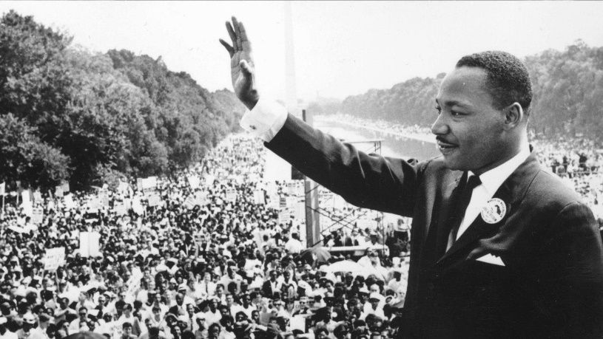
Year 10 Subject Selection for Stage 6
Modern History (Cat A) (New Course)
The study of Modern History in Stage 6 enables students to:
  develop knowledge and understanding of the modern world, the skills of critical analysis, and values and attitudes essential for an appreciation of the people, forces and ideas that have shaped the modern world
  develop a lifelong interest in the study of history
  prepare for active and informed citizenship in the contemporary world.

Slide 32
Year 10 Subject Selection for Stage 6
Topics studied include:
  The Nature of Modern History - How we portray the past: Film Analysis: Titanic
  Case Studies - Break up of Yugoslavia/ The Rise of Muslim Fundamentalism after Iranian Revolution 1979
  The Shaping of the Modern World Core Study - Power and Authority: The Rise of Nazi Germany
  National Studies - Twentieth Century Russia/ USSR
  Peace and Conflict - Conflict in Indochina 1954-1975
  Change in the Modern World - Civil Rights in the USA 1945-1968

Slide 33
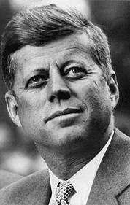
Year 10 Subject Selection for Stage 6
History
Extension
(Cat A)
(New Course)
Through the study of HSC History Extension, students will: learn about:
significant historiographical ideas and processes learn to
design, undertake and communicate historical inquiry, appreciate
the way history has been recorded over time
the value of history for critical interpretation of the contemporary world
the contribution of historical studies towards life-long learning.
Topics studied include:
How is history studied? How do our perceptions alter over time?
Case study: John Fitzgerald Kennedy
History Project: Individual historical investigation on area of interest.
The extension course is only available to students of either Modern or Ancient History in Year 12

Slide 34



Year 10 Subject Selection for Stage 6
Languages
French, Italian, Spanish – (Beginners) (Cat A)
A Language Beginners course is a two year course designed for students who have little or no experience of studying the language. Students therefore have the opportunity of starting the subject in Year 11 with no assumed prior knowledge or who have only studied a language in Year 8.

Slide 35
Year 10 Subject Selection for Stage 6
The study a Beginner Languages in Stage 6 enables students to:
  develop skills in listening, speaking, reading and writing in the target language as they interpret and respond to a variety of texts within the differing contexts of the topics studied.
  understand language as a system, which in turn promotes improved literacy and understanding in their first language
  prepare for citizenship in an increasingly globalised world where intercultural knowledge and language skills are becoming essential

Slide 36
Year 10 Subject Selection for Stage 6
Topics studied include:
  Family life, home and neighbourhood
  People, places and communities
  Education and work
  Friends, recreation and pastimes
  Holidays, travel and tourism
  Future plans and aspirations.

Slide 37
Year 10 Subject Selection for Stage 6
Mathematics – Year 11
Mathematics (Cat A)
Mathematics Extension 1 (must be studied with Mathematics) (Cat A)
Mathematics Standard (Cat A) (New Course)
Notes:
The Mathematics Standard courses are focused on enabling students to use mathematics effectively, efficiently and critically to make informed decisions in their daily lives. They provide students with the opportunities to develop an understanding of, and competence in, further aspects of mathematics through a large variety of real-world applications for a range of concurrent HSC subjects.
Mathematics provides students with the opportunity to develop ways of thinking in which problems are explored through observation, reflection and reasoning. The course provides a basis for further studies in disciplines in which mathematics and the skills that constitute thinking mathematically have an important role. It is designed for those students whose future pathways may involve mathematics and its applications in a range of disciplines at the tertiary level.
Mathematics Extension 1 is focused on enabling students to develop a thorough understanding of and competence in further aspects of mathematics. Mathematics Extension 1 provides a basis for progression to further study in mathematics or related disciplines in which mathematics has a vital role at a tertiary level. An understanding and exploration of Mathematics Extension 1 is also advantageous for further studies in such areas as science, engineering, finance and economics.
The Mathematics Advanced course must be chosen if students wish to study Mathematics Extension courses.
The Mathematics Standard course is a common course in the Preliminary year. Students, in consultation with the Mathematics Faculty, nominate to do either Mathematics Standard 1 or Mathematics Standard 2, in the HSC year.
The study of mathematics is not compulsory for the HSC or ATAR.
http://syllabus.nesa.nsw.edu.au/stage-6/
http://syllabus.nesa.nsw.edu.au/mathematics/

Slide 38
Year 10 Subject Selection for Stage 6
When choosing Years 11 and 12 (Stage 6) Mathematics, consider the pathway you are currently studying:
Stage 5.1
Only very capable Stage 5.1 students should proceed to Year 11 and Year 12 Mathematics Standard courses.
Stage 5.1 does not provide a basis for Year 11 Mathematics, Year 11 Extension, Year 12 Mathematics or Year 12 Extensions 1 and 2 in Stage 6.
Stage 5.2
Is a good basis for Preliminary and HSC Mathematics Standard
Stage 5.3
Is a good basis for all levels of Stage 6 Mathematics.

Slide 39
Year 10 Subject Selection for Stage 6
Course progression

Slide 40
Year 10 Subject Selection for Stage 6
Mathematics – Year 12
Mathematics (Cat A)
  Mathematics Extension 1 (must be studied with Mathematics)
  Mathematics Extension 2 (must be studied with Mathematics Extension 1)
Mathematics Standard 2 (Cat A) (New Course)
Mathematics Standard 1 (Cat B) (New Course)
Notes:
Mathematics Standard 1 is designed to help students improve their numeracy by building their confidence and success in making mathematics meaningful. This course offers students the opportunity to prepare for post-school options of employment or further training. This course offers an optional HSC examination.
Mathematics Standard 2 is designed for those students who want to extend their mathematical skills beyond Stage 5 but are not seeking the in-depth knowledge of higher mathematics that the study of calculus would provide. This course offers students the opportunity to prepare for a wide range of educational and employment aspirations, including continuing their studies at a tertiary level.
Students studying Mathematics Standard 1 may elect to undertake an optional HSC examination. The examination mark may be used by the Universities Admissions Centre (UAC) to contribute to the student’s Australian Tertiary Admission Rank (ATAR).
All students studying Mathematics Standard 2 will sit for an HSC examination.
Mathematics Advanced provides students with the opportunity to develop ways of thinking in which problems are explored through observation, reflection and reasoning. The course provides a basis for further studies in disciplines in which mathematics and the skills that constitute thinking mathematically have an important role. It is designed for those students whose future pathways may involve mathematics and its applications in a range of disciplines at the tertiary level.
Mathematics Extension 1 is focused on enabling students to develop a thorough understanding of and competence in further aspects of mathematics. Mathematics Extension 1 provides a basis for progression to further study in mathematics or related disciplines in which mathematics has a vital role at a tertiary level. An understanding and exploration of Mathematics Extension 1 is also advantageous for further studies in such areas as science, engineering, finance and economics.
Mathematics Extension 2 provides students with the opportunity to develop strong mathematical manipulative skills and a deep understanding of the fundamental ideas of algebra and calculus. It extends students conceptual knowledge and understanding through exploration of new areas of mathematics not previously seen. Mathematics Extension 2 provides a basis for a wide range of useful applications of mathematics as well as a strong foundation for further study of the subject.
The Mathematics Advanced course must be chosen if students wish to study Mathematics Extension courses.
http://syllabus.nesa.nsw.edu.au/stage-6/
http://syllabus.nesa.nsw.edu.au/mathematics/

Slide 41

Year 10 Subject Selection for Stage 6
PDHPE
PDHPE Course (Cat A)
  Category A subject - ATAR subject
  Theory based subject
  No scheduled practical lessons

Slide 42
Year 10 Subject Selection for Stage 6
Topics covered
Year 11 Course – Better health for individuals, Body in motion and 2 options (Outdoor recreation, First Aid, Composition and performance and Fitness choices)
Year 12 Course – Health priorities in Australia, Factors affecting performance and 2 options (Sports medicine, Improving performance, Equity and health, Sport and physical activity in Australia and The health of young people)

Slide 43

Year 10 Subject Selection for Stage 6
Dance (Cat A)
Category A subject - ATAR subject
Theory (50%) and practical (50%) subject
Students will develop knowledge and understanding, skills and attitudes about the THREE dance objectives:
        Dance performance
        Dance composition
        Dance appreciation

Slide 44

Year 10 Subject Selection for Stage 6
Sports Lifestyle and Recreation – SLR
(Cat B)
Category B subject - Non ATAR subject
Theory (30%) and practical (70%) subject
Students will complete the following modules over the 2 years (Athletics, First Aid, Fitness, Games and Sports, Healthy Lifestyle, Individual Games and Sports Applications, Outdoor Recreation, Resistance Training, Social Perspectives, Sports Administration, Sports Coaching)
Students will be required to put into practice skills developed throughout the course at Field days and sports carnivals as coaches and managers

Slide 45

Year 10 Subject Selection for Stage 6
Science
Biology (New Course) (Cat A)
  should be at least a C student
  Humans, plants, animals, ecology, DNA, disease, evolution
  Careers: Zoologist, Geneticist, lab tech, pathology
Chemistry (New Course) (Cat A)
  should be at least a C student
  Matter, Reactions, quantitative, acid/base, organic chemistry
  Careers: Engineer, research scientist, pharmacist, drug design and development, forensics

Slide 46
Year 10 Subject Selection for Stage 6
Earth and Environmental Science (New Course) (Cat A)
  should be at least a C student
  Earths resources, plate tectonics, human impact, climate science, hazards
  Careers: Environmentalists, ecologists, mining, resource management
Physics (New Course) (Cat A)
  should be at least a B student who should be studying Mathematics
  Space, Light, Motion, electricity, magnetism, Universe to the atom
  Careers: Astronomers, engineers, mathematicians, computer scientists

Slide 47

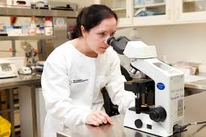
Year 10 Subject Selection for Stage 6
Investigating Science (New Course)
(Cat A)
  should be at least a C student
  NOT Senior Science
  Goes very well with the other sciences
  Be an authentic scientist. Conduct investigations from your own interests. Focus on the skills a scientist needs.
  Mandatory depth study for 30 hours

Slide 48
Year 10 Subject Selection for Stage 6
Depth Study
A depth study is any type of investigation/activity that a student completes individually or collaboratively that allows the further development of one or more concepts found within or inspired by the syllabus.
Depth studies provide opportunities for students to pursue their interests in science, acquire a depth of understanding, and take responsibility for their own learning.
A depth study may be:
  a practical investigation or a secondary-sourced investigation
  presentations, research assignments or fieldwork reports
  Mandatory component in each science course

Slide 49
Year 10 Subject Selection for Stage 6
Science Extension (New Course) (Cat A)
Science Extension is a 1 Unit course studied in Year 12 in 2019.
Designed for high achieving science students.
Students will:
investigate the development of current scientific thinking and scientific research methodologies including the statistical analysis of large data sets
conduct a professional literature review to determine a research question
find patterns and trends in data using statistical analysis to determine evidence that supports or refutes their hypothesis
write an authentic Scientific Research Report.

Slide 50


Year 10 Subject Selection for Stage 6
Social Sciences
Business Studies (Cat A)
Offers learning in the planning of a small business to the management of operations, marketing, finance and human resources in large businesses.
Economics (Cat A)
Learning in assessing economic issues and
proposing solutions to economic problems,
including economic modelling on a local and
global scale.
Geography (Cat A)
Understanding environmental change and the interactions which take place in our world.
Major Work- Senior Geography Project

Slide 51

Year 10 Subject Selection for Stage 6
Legal Studies (Cat A)
Focuses on the way in which law is generated, how it is structured and how it operates in Australian and international contexts.
Studies of Religion II (Cat A)
Investigates the types of religions, its characteristics and the significance of religion in society and within Australian.
Society and Culture (Cat A)
Awareness of the nature of power and authority, gender,
technology and facilitates intercultural understanding.
Major Work- PIP
Work studies (Cat B)
Students are engaged in work and develop and enhance their skills that lead to a successful transition to the workplace, further education and training and preparation for the future world of work.

Slide 52
Year 10 Subject Selection for Stage 6
Technological and applied studies (TAS)
Community and Family Studies (Cat A)
Develops skills and understanding in resource management, decision making, problem solving, effective relationships within own families and other groups.
Design and Technology (Cat A)
Focuses on creativity, innovation and the successful implementation of innovative ideas. Students will develop design projects in areas of individual interest. Course fee: $45.00
Exploring Early Childhood (Cat B)
Investigate a range of issues related to individuals, their family, community and childhood issues. Course fee: $20.00

Slide 53
Year 10 Subject Selection for Stage 6
Food Technology (Cat A)
Investigate factors related to food selection and contemporary nutrition issues.
Experiment with, design and prepare food to a range of food situations that provide benefits for both vocational and life experiences. Course fee: $70.00
Information Processes and Technology (Cat A)
Select the most appropriate technology for a given situation.
Design and implement an information-based system using a creative and methodical approach.
Textiles and Design (Cat A)
Develop technological and practical skills related to textiles and design.
Develop creativity, project management skills that promote self-esteem and satisfaction through completion of various textiles projects.
Course fee: $30.00

Slide 54
Year 10 Subject Selection for Stage 6
Vocational Education & Training (VET)
Business Services - BSB20115 Certificate II in Business (Cat B)
This qualification reflects the role of individuals in a variety of junior administrative positions who perform a range of mainly routine tasks using limited practical skills and fundamental operational knowledge in a defined context. Individuals in these roles generally work under direct supervision.
Cost - $15.00
Entertainment - CUA30415 Certificate III in Live Production and Services
(Cat B)
This qualification is designed to reflect the role of individuals who work in technical production areas, who perform a range of skilled tasks using discretion and judgement, and who have the ability to select, adapt and transfer skills to different situations.
Cost- $215
Notes:
http://educationstandards.nsw.edu.au/wps/portal/nesa/11-12/stage-6-learning-areas/vet
http://ace.bostes.nsw.edu.au/higher-school-certificate/internal-assessment/vet

Slide 55

Year 10 Subject Selection for Stage 6
HOSPITALITY – Food and Beverage - SIT20316 Certificate II in Hospitality (Cat B)
This qualification provides a pathway to work in various hospitality settings, such as restaurants, hotels, motels, catering operations, clubs, pubs, cafes and coffee shops.
Cost-$ 160.00
HOSPITALITY – Kitchen Operations - SIT20416
Certificate II in Kitchen Operations (Cat B)
This qualification provides a pathway to work in kitchen operations in organisations such as restaurants, hotels, catering operations, clubs, pubs, cafes, cafeterias, coffee shops and institutions such as aged care facilities, hospitals, prisons and schools.
Cost- $ 190.00

Slide 56

Year 10 Subject Selection for Stage 6
RETAIL SERVICES - SIR30216 Certificate III in Retail Services (Cat B)
With this qualification the student is able to perform roles such as, providing product and service advice in a retail store. Selling products and services in a variety of retail settings and operating the cash register. Also organising and maintaining work areas, merchandising and building dis
Cost- $15.00
Work placement (70 hours) is a mandatory component of all VET courses. Students will not qualify without the work placement of 70 hours completed.

Slide 57
Year 10 Subject Selection for Stage 6
Industry curriculum framework
Board Developed HSC VET syllabus
Based on nationally endorsed Training Package(s)
    lists which qualifications and units of competency have been included in the HSC syllabus
    describes how units of competency are arranged into HSC VET courses
Includes HSC outcomes and content
Has an optional HSC examination
    provides access to ATAR pathway
Includes a mandatory work placement
Notes:
VET Framework courses:
have Board Developed status.
provide nationally recognised qualifications - Qualifications are recognised Australia-wide (AQF – Australian Qualifications Framework)
can provide direct access to employment and further training
are based on competency-based assessment
contribute units towards the attainment of the HSC
Students must meet both the vocational requirements as specified by the relevant Training Package as well as the NESA syllabus requirements in order to be awarded the appropriate AQF Certificate and for the units to be recognised for the HSC.
UAC will include a maximum of 2 units towards the calculation of ATAR if the optional examination is completed
Courses can be delivered by a range of providers including schools, TAFEs and other registered training organisations
Part of NESA requirement is that students complete 70 hours mandatory work placement for a 240 hour course.
http://educationstandards.nsw.edu.au/wps/portal/nesa/11-12/stage-6-learning-areas/vet
http://ace.bostes.nsw.edu.au/higher-school-certificate/internal-assessment/vet
http://ace.bostes.nsw.edu.au/ace-8019
http://ace.bostes.nsw.edu.au/ace-8093

Slide 58
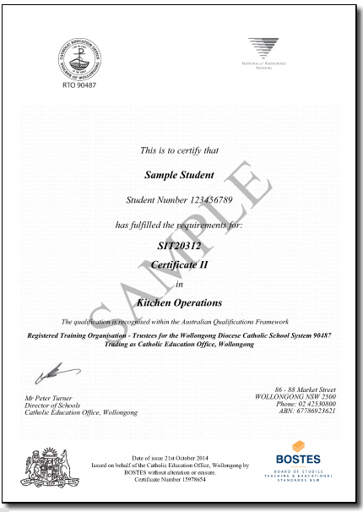
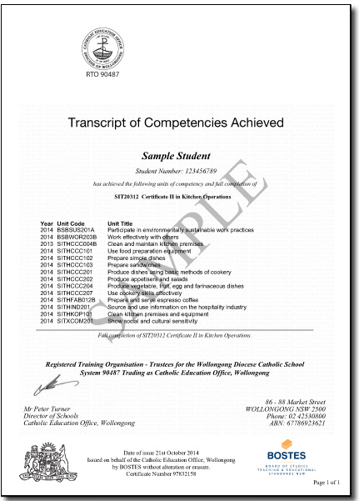
Year 10 Subject Selection for Stage 6
VET Credentials
Notes:
An AQF Certificate is awarded to students in Vocational Education and Training (VET) courses who successfully complete all requirements of an Australian Qualifications Framework (AQF) Certificate.
A Statement of Attainment is issued to students in VET courses who partially complete the requirements of an AQF Certificate.
http://educationstandards.nsw.edu.au/wps/portal/nesa/11-12/hsc/results-certificates/vet-qualifications

Slide 59
Year 10 Subject Selection for Stage 6
Other Considerations
What do I want for my future?
  What ‘pathway’ best suits me?
Ask for advice from:
      teachers
      parents
      Year adviser
      careers adviser
Notes:
http://educationstandards.nsw.edu.au/wps/portal/nesa/11-12/hsc/subject-selection

